Slide 1
Prediction of AEs
Severe irAEs
Specific irAEs (Rash)
Chemo-associated AEs

Slide 2
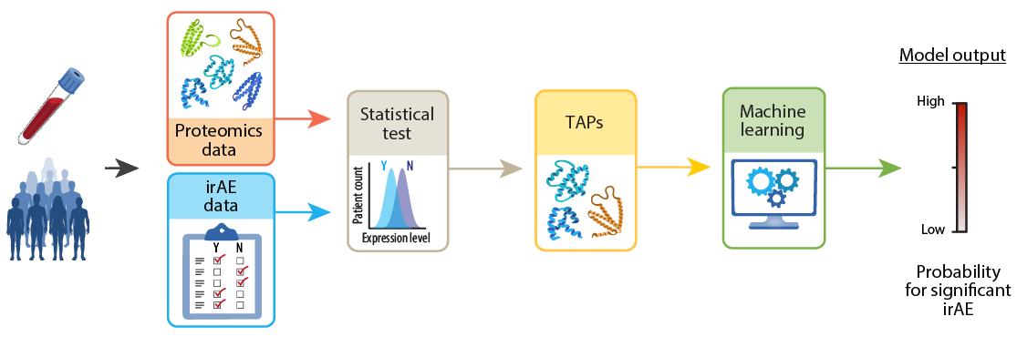
Severe immune-related adverse events (irAE) Prediction
Workflow and cohort description
Definition:
Severe irAE: grade ≥3 irAEs within the first 100 days that leading to treatment discontinuation
Prophet Trial:
irAE Cohort (n= 426)
Category | Parameter | # of patients
Sex | Male | 249
 | Female | 177
ECOG | 0 | 136
 | 1 | 240
 | 2 | 47
 | Unknown | 3
Histology | non-SqCC | 312
 | SqCC | 97
 | Unknown | 17
Treatment type | ICI+Chemo | 151
 | ICI | 275
Proteomic Assessment:
Identify proteomic signature associated with irAEs:
TAP: ‘Toxicity Associated Proteins’
Machine learning algorithm associates with irAE development
irAE: annotated by treating physicians

Slide 3
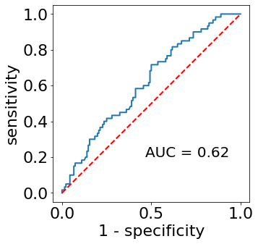
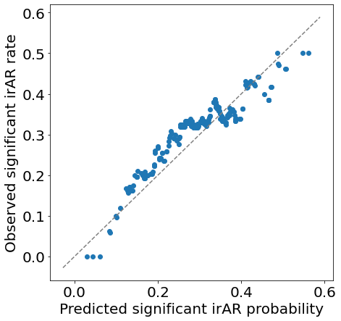
Performance evaluation of the irAE predictor
Cross-validation results
1.0
0.6
0.5
0.8
0.4
0.6
Severe irAE rate
Sensitivity
0.3
0.4
0.2
0.2
AUC = 0.62
p-value: 0.004
0.1
R² = 0.88
p-value: 0.0016
0.0
0.0
0.0
0.5
1.0
0.0
0.2
0.4
0.6
1-Specificity
Predicted severe irAE probability
irAE model demonstrated statistically significant predictive capabilities
High correlation between predicted severe irAE probability and the observed severe irAE rate

Slide 4
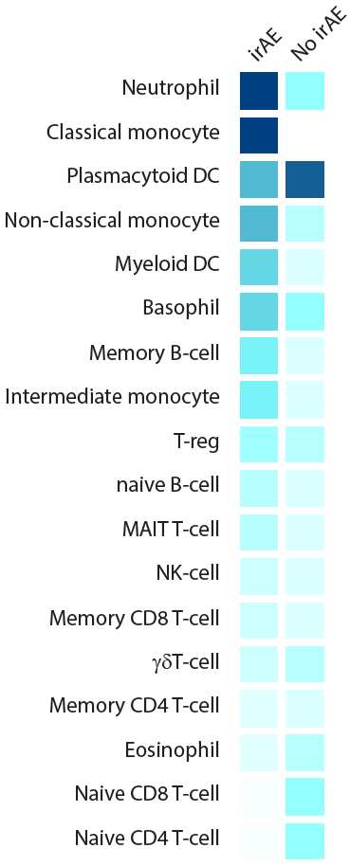
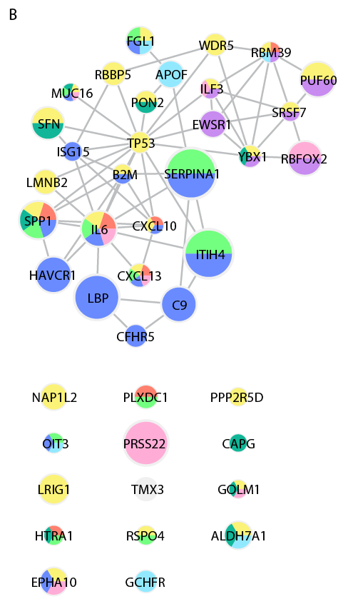
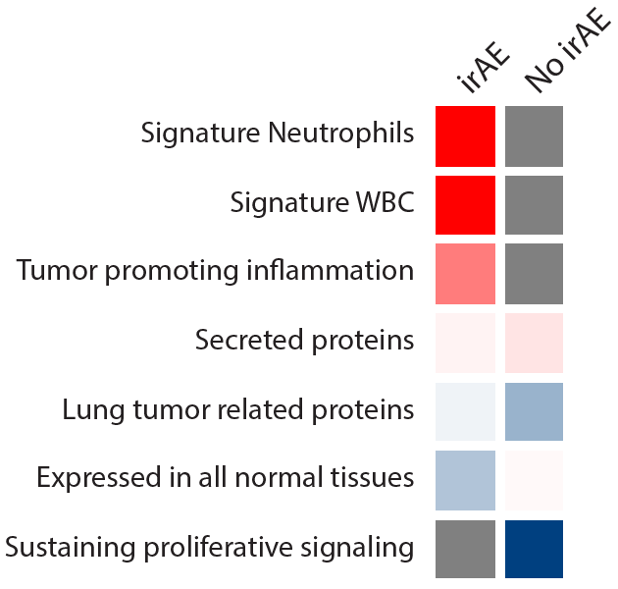
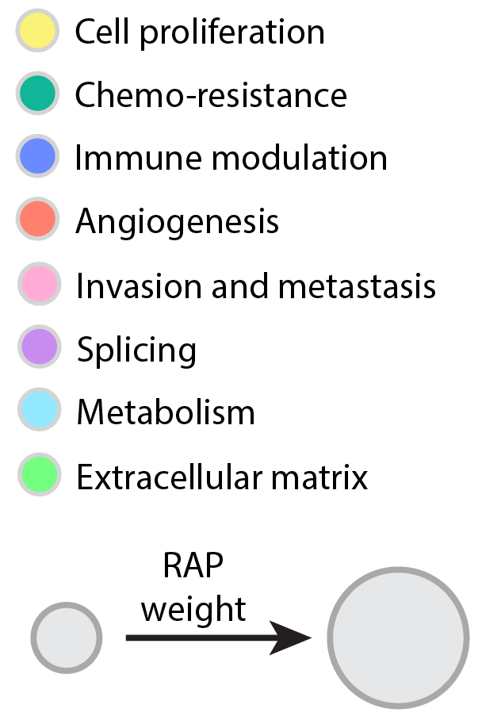
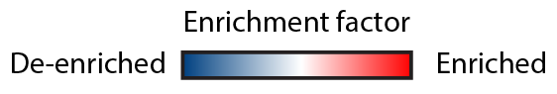
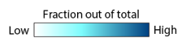
Key biological signals from each model
Each model displays distinct biology
Resistance-Associated Proteins (RAPs)
Toxicity-Associated Proteins (TAPs)
Mainly myeloblast-origin
Mainly lymphocytes
Fisher exact test; FDR<0.1
Proteins higher in no clinical benefit are involved in different resistance mechanisms
Neutrophil and monocyte related proteins

Slide 5
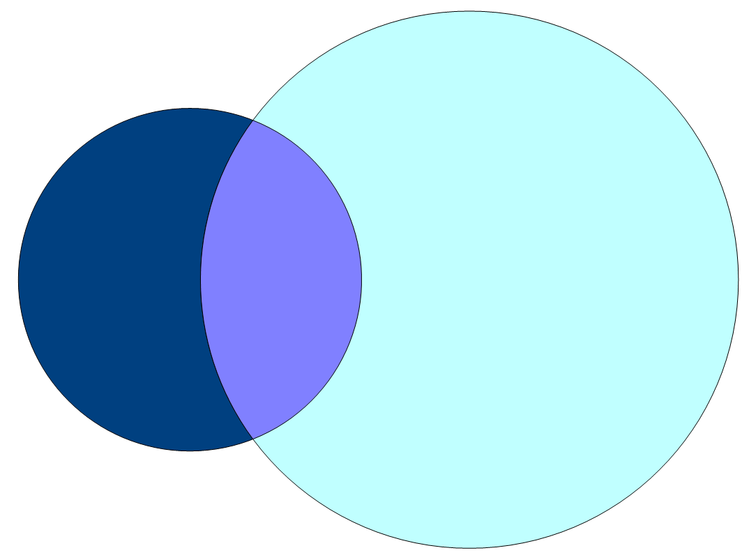
Key biological signals from each model
Small overlap between efficacy and toxicity predictions
TAPs
RAPs
81
32
199
RAP = Resistance-Associated Protein
TAP = Toxicity-Associated Protein
Minimal overlap between proteins associated with clinical benefit (RAP) and irAEs (TAP)

Slide 6
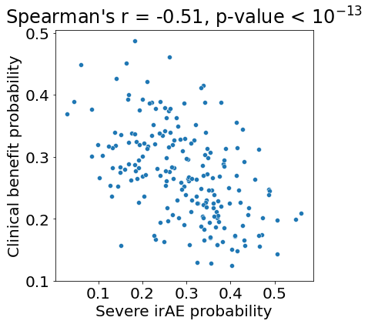
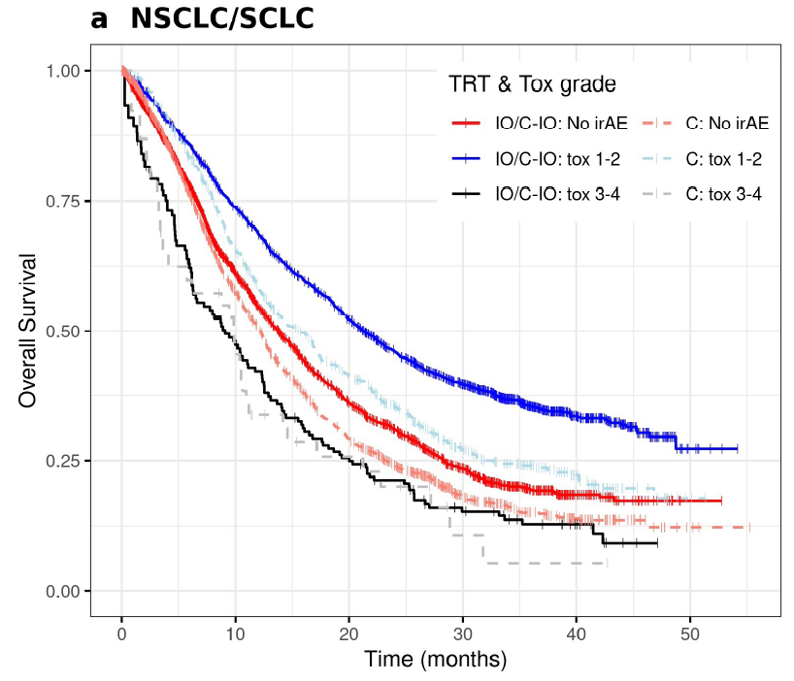
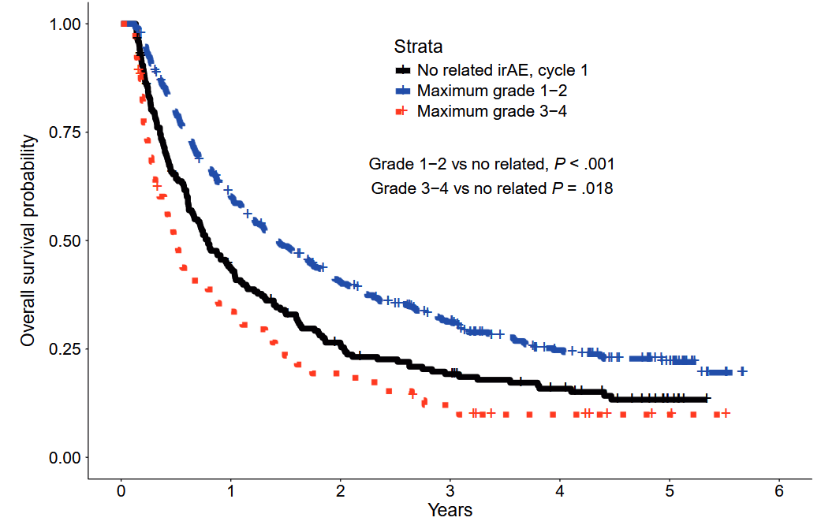
Correlation Between PROphet (Clinical Benefit) and PROphet-irAE Predictions
0.5
Spearman’s r = -0.51
p-value = 10⁻¹³
Published studies:
NSCLC; Atezo ± chemo/targeted
Rare cancers (NCT02834013); Ipi-Nivo
0.4
0.3
Clinical benefit probability
0.2
0.1
0.1
0.2
0.3
0.4
0.5
Severe irAE probability
Durán-Pacheco et al., JITC 2024
Othus et al., JNCI 2024
Negative correlation between irAE probability and clinical benefit
High-grade irAEs are associated with poor OS

Slide 7
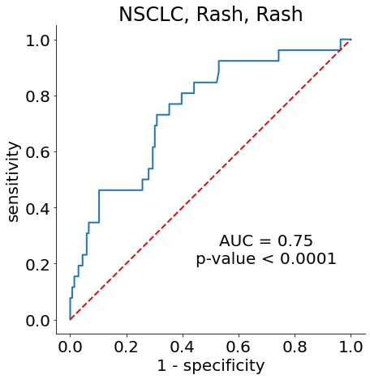
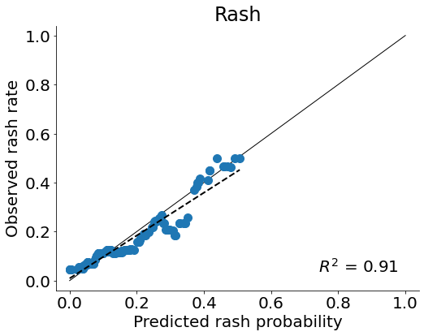
Specific-irAE Prediction (Test Case: Rash)
Predictive model
Prophet Trial: Rash Cohort (n= 162)
Category | Parameter | Rash cohort
Sex | Male | 96
 | Female | 66
ECOG | 0 | 55
 | 1 | 96
 | 2 | 11
Histology | Non-squamous | 120
 | Squamous | 38
 | Unknown | 4
Treatment type | ICI+Chemo | 50
 | ICI monotherapy | 109
 | Ipi Nivo | 3
1.0
1.0
0.8
0.8
0.6
Rash irAE rate
Sensitivity
0.6
0.4
0.4
0.2
AUC = 0.75
p-value < 0.0001
0.2
R² = 0.91
p-value: 0.018
0.0
0.0
0.0
0.2
0.4
0.6
0.8
1.0
0.0
0.2
0.4
0.6
0.8
1.0
1-Specificity
Predicted rash irAE probability
Rash model demonstrated statistically significant predictive capabilities
High correlation between predicted rash probability and the observed rash rate

Slide 8
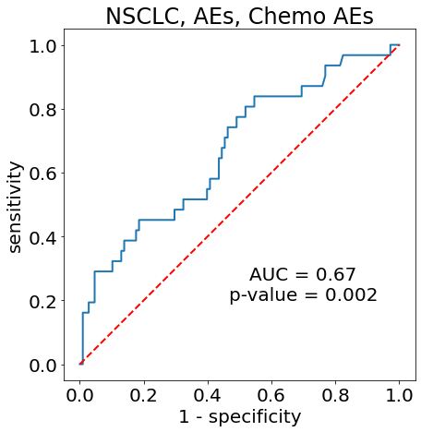
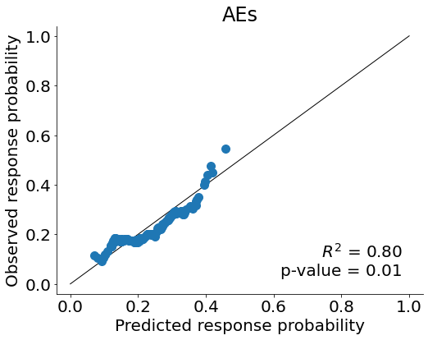
Chemo-Associated AE Prediction
Predictive model
Prophet Trial: Chemo Cohort (n= 138)*
Category | Parameter | Chemo cohort
Sex | Male | 96
 | Female | 42
ECOG | 0 | 68
 | 1 | 68
 | 2 | 1
 | Unknown | 1
Histology | Non-squamous | 92
 | Squamous | 45
 | Unknown | 1
Treatment | Platinum doublet | 138
1.0
1.0
0.8
0.8
0.6
0.6
Sensitivity
Chemo-associated AE rate
0.4
0.4
* Historic 1L cohort
0.2
AUC = 0.67
p-value = 0.002
0.2
R² = 0.80
p-value: 0.01
Effects of AEs on treatment
0.0
0.0
0.0
0.2
0.4
0.6
0.8
1.0
0.0
0.2
0.4
0.6
0.8
1.0
1.0
1-Specificity
Predicted chemo-associated AE probability
Chemo-AE model demonstrated statistically significant predictive capabilities
High correlation between predicted chemo-AE probability and the observed chemo-AE rate
23 patients (74% of those who experienced chemo AEs) modified / stopped treatment due to AE

Slide 9
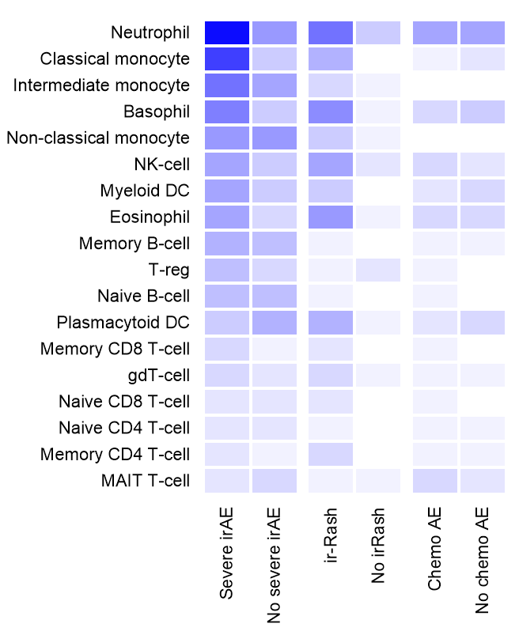
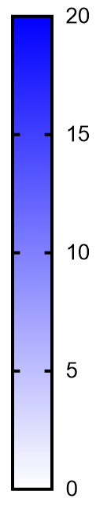
The 3 models differ in the proteomic signatures
Model proteins
Main biological signal in each model
Immune cell-related TAPs
Severe irAEs
Rash-irAEs
178
27
71
Number of toxicity-associated proteins
2
15
7
Chemo-AEs
Rash-irAEs
90
Severe irAEs
Chemo-AEs
Enrichment analysis
(Fisher’s Exact test, FDR<0.1)
Unique proteins in each model
Large overlap between severe and rash irAEs, fewer with chemo AEs
Distinct underlying biology in each type of toxicity model
Models include correction for multiple hypothesis testing
Larger number of neutrophil-related proteins in patients with severe irAEs and rash irAEs
ChemoAE predictor involves fewer immune-related proteins compared to irAEs (severe / rash) predictors

